Slide 1


Slide 2
Agenda
Project Recap
Problem
The Analytics Team
Insight
Summary

Slide 3
Project recap
Social Buzz , a social media and content creation platform established in 2010,with headquarters in San Francisco
Objective
Contact an audit of their big data
Provide recommendations to support a successful IPO
Analyze content categories to identify the top 5 categories with the largest aggregate popularity

Slide 4
problem
Over 100000 posts per day
36500000 pieces of content per year
but how to find capitalize on it when there is so much?
Analysis to find social buzz’s top 5 most popular categories of content

Slide 5
THE ANALYTICS TEAM
Andrew Fleming
Marcus Rompton
Nirmal Sharma

Slide 6
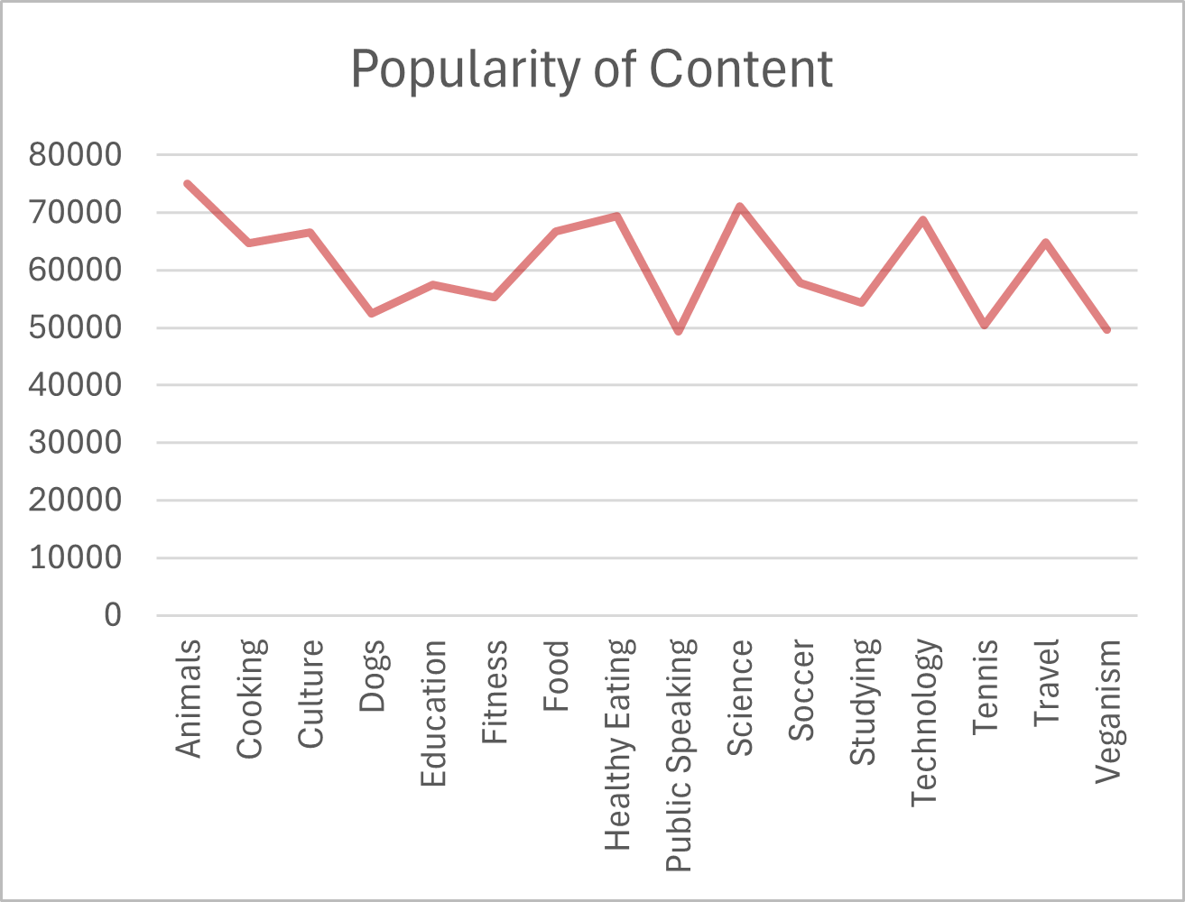
Top 5 Content Category On The Basis aggregate Popularity
ALL CONTENT CATEGORY
S.NO | Content Category | Score
1 | Animals | 74965
2 | Science | 71168
3 | Healthy Eating | 69339
4 | Technology | 68738
5 | Food | 66676

Slide 7
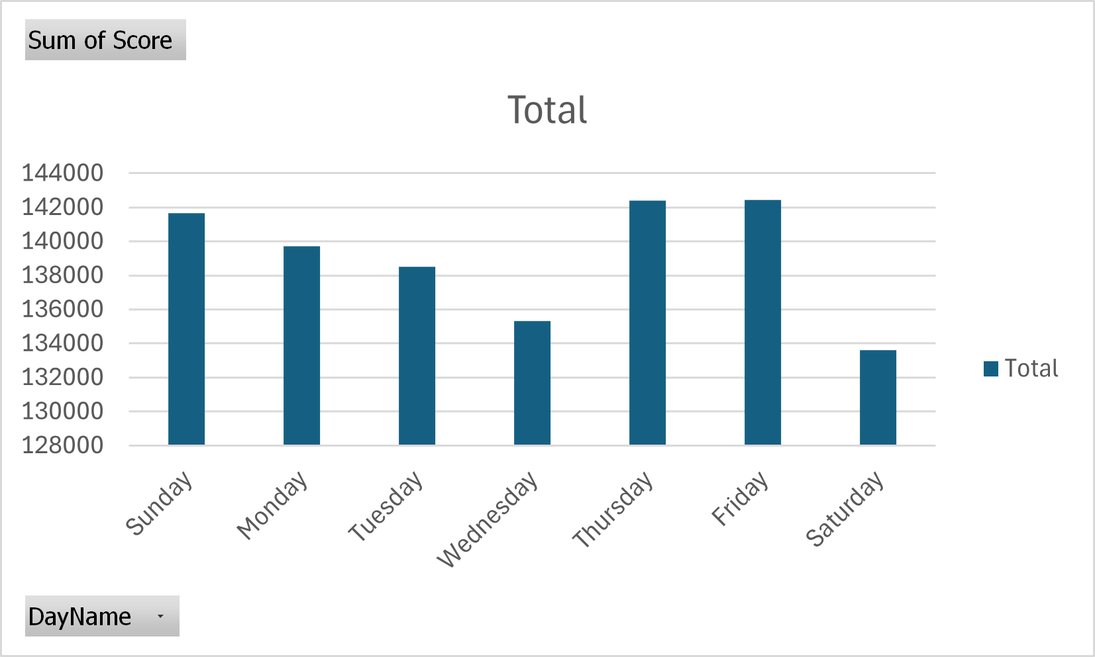
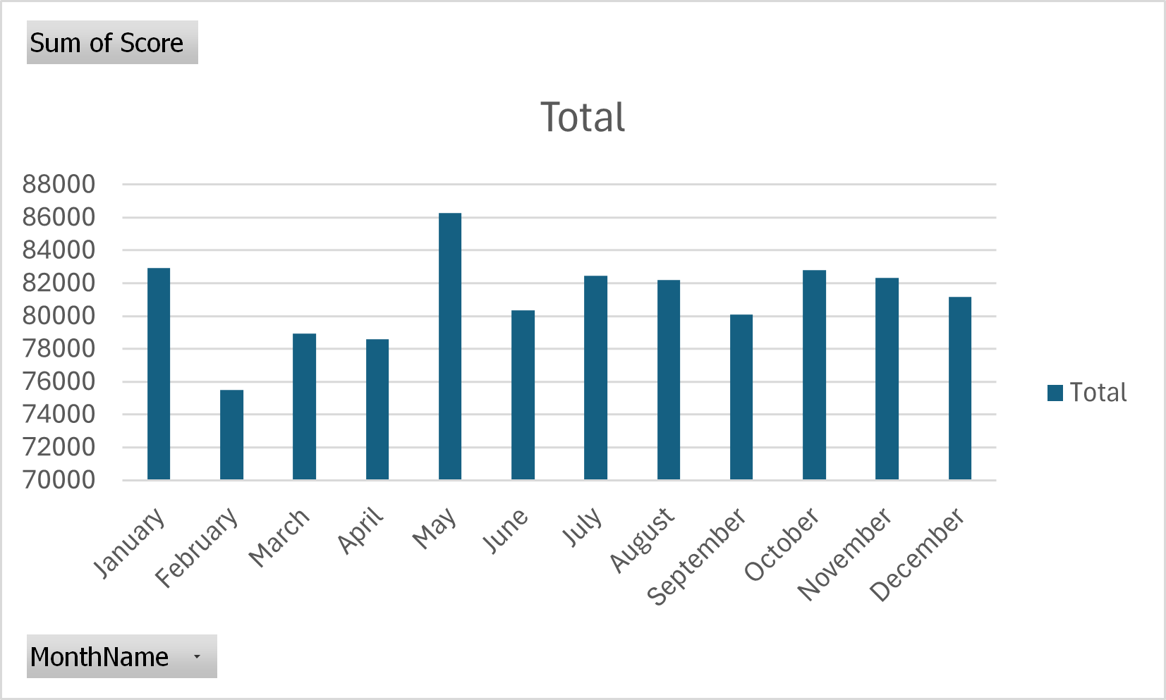
Aggregate score of months
Aggregate score of days

Slide 8
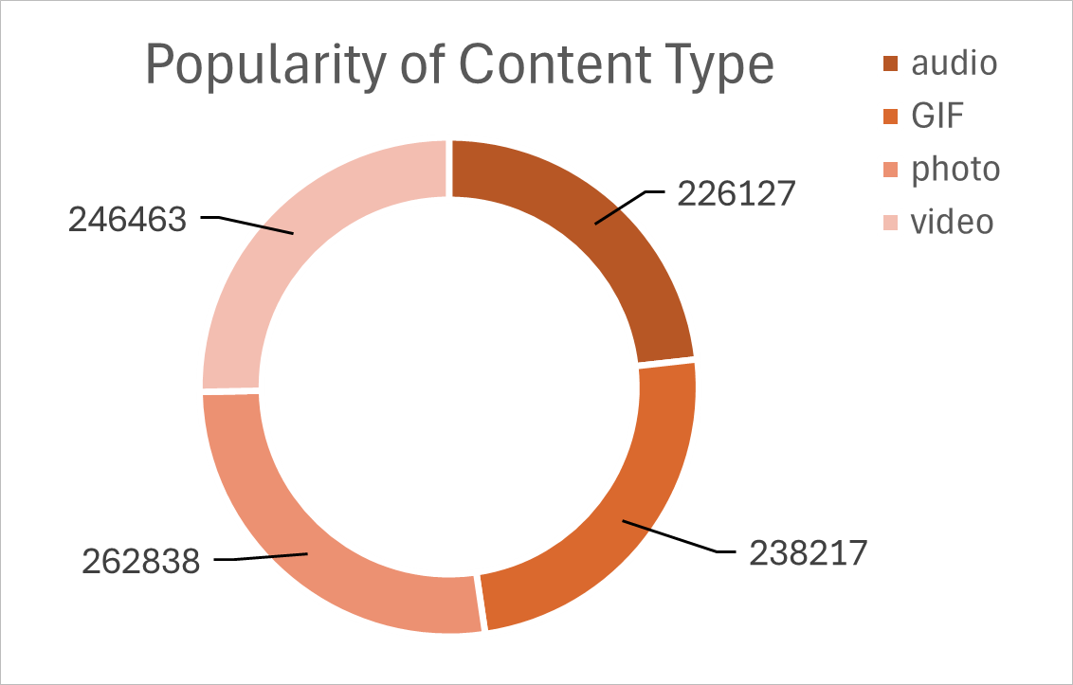
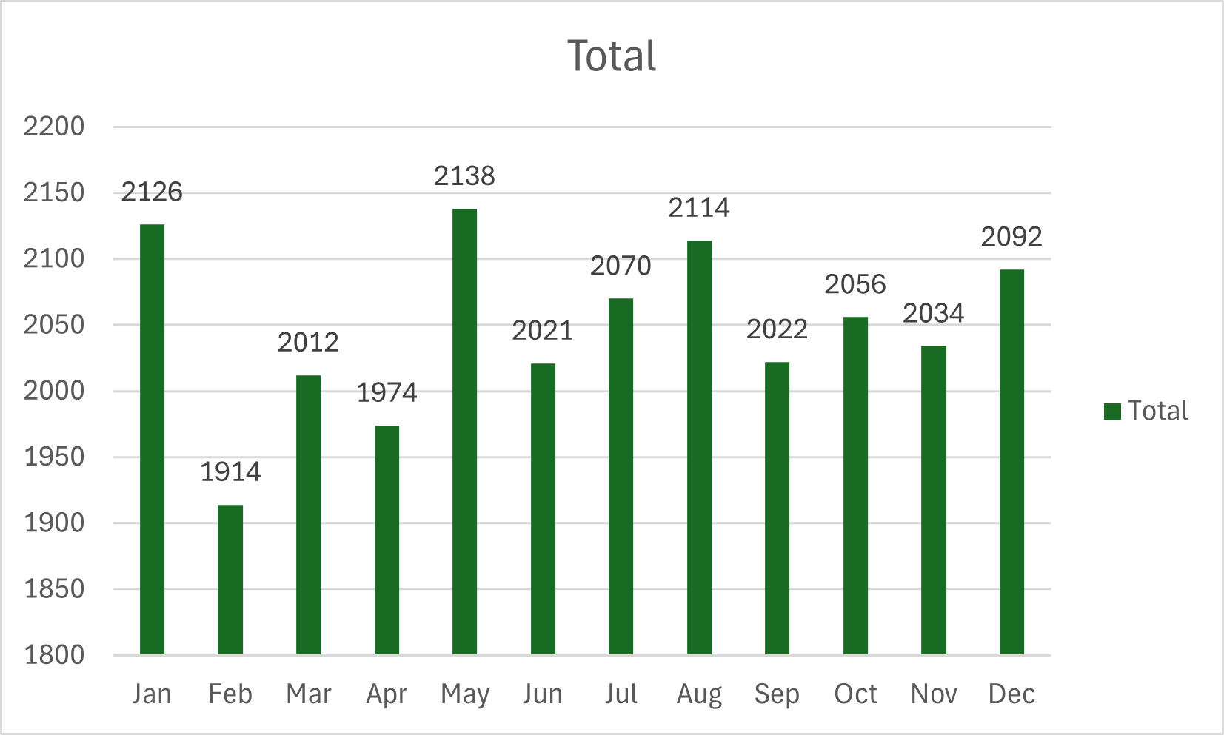
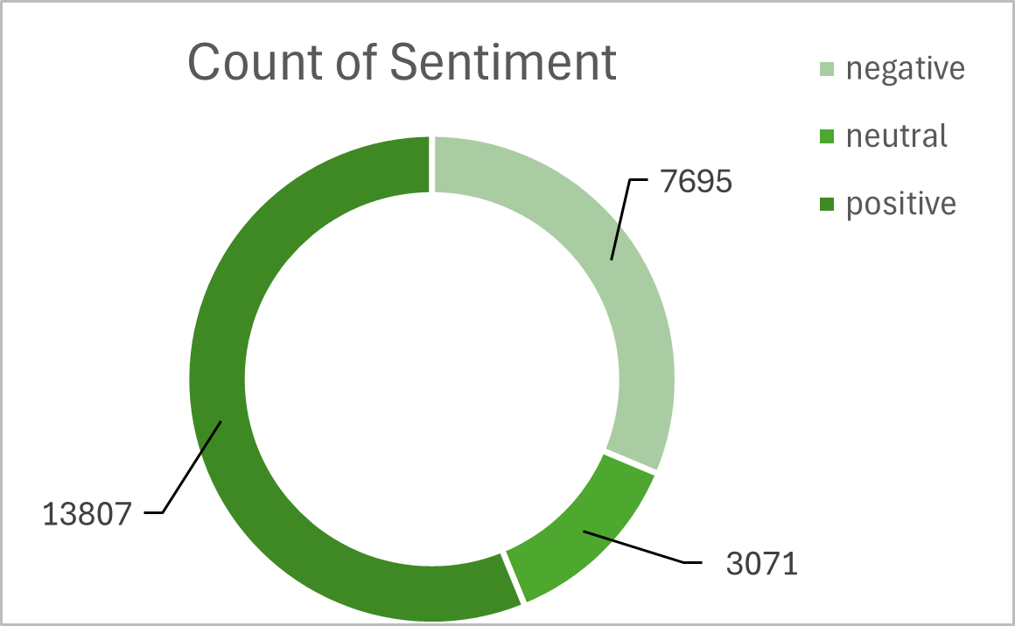
Total Reaction 24573

Slide 9
insights
January Month has highest posts
Reaction to Animals posts is 1827

Slide 10
Summary
The Social Buzz project provided crucial insights into the platform’s content performance. By analyzing a vast dataset of over 36.5 million posts annually, we identified the top 5 content categories with the highest engagement. These insights are instrumental in guiding strategic decisions for Social Buzz’s future growth and success, particularly as it prepares for its IPO. Moving forward, these findings can be leveraged to optimize content strategies, enhance audience engagement, and strengthen the platform's market position

